Slide 1
VOPE
The style in your pulse
By Victoria Pelegrino

Slide 2
Sole Proprietorship
Ease of start Lonely at The Top
Own decisions Long hours of work
Profit goes to the owner Unlimited risks
No corporate tax payments Difficult to raise capital

Slide 3
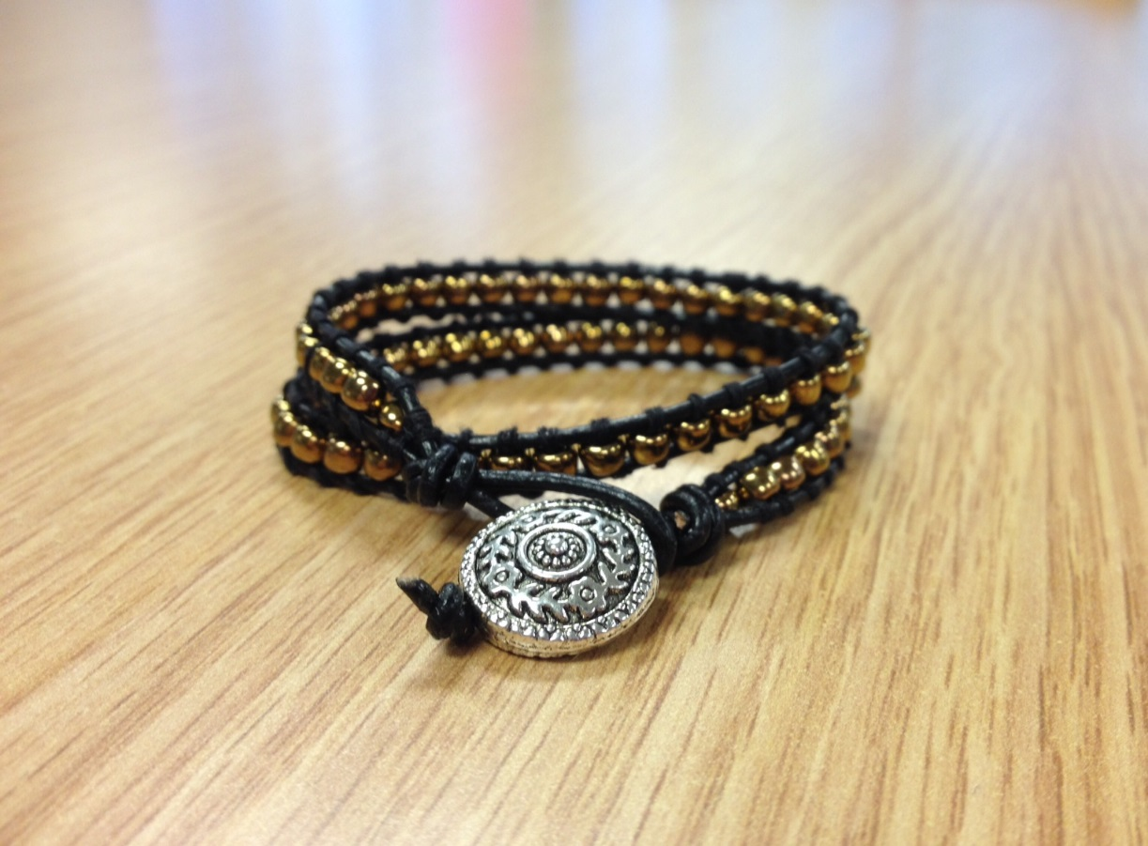
Beaded Wrapped Bracelets

Slide 4
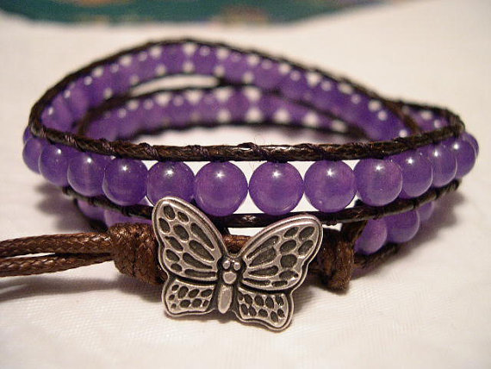
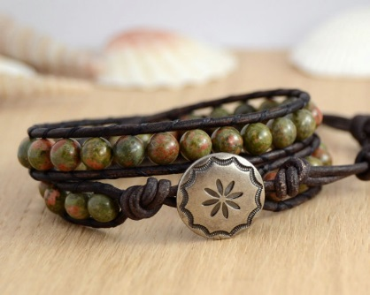
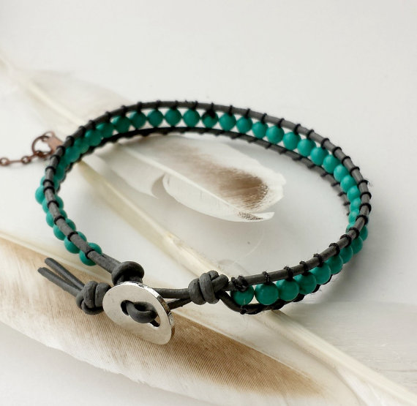
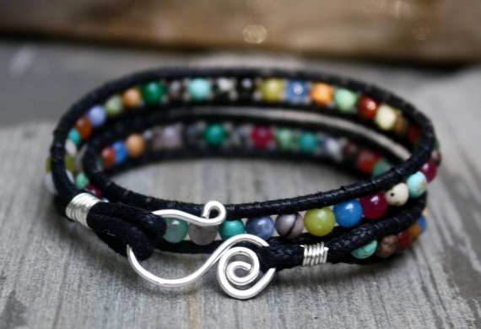

Slide 5
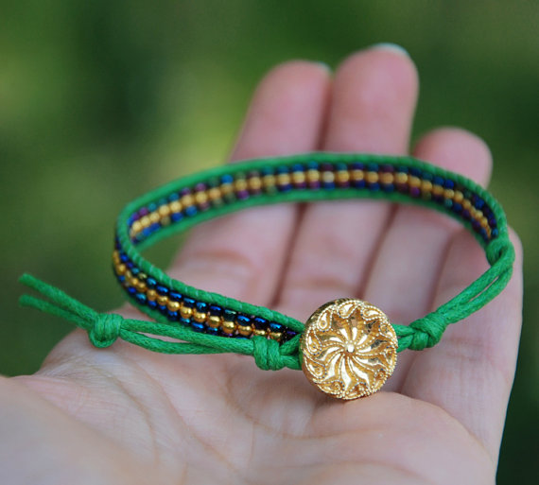
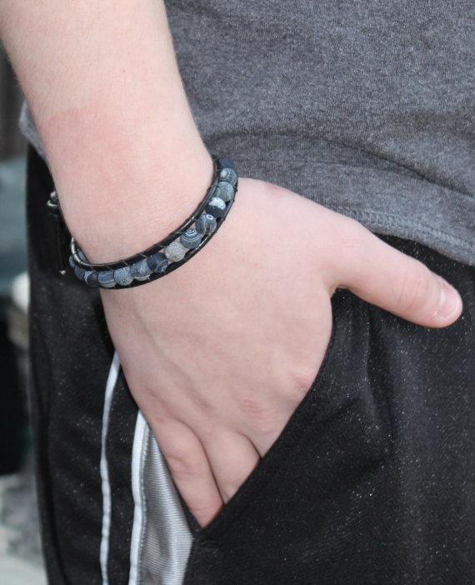
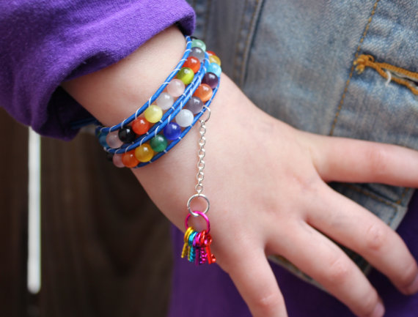
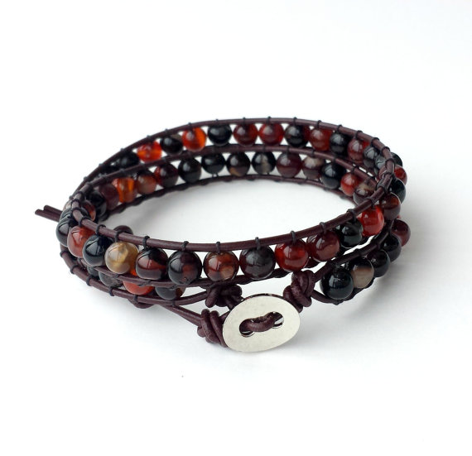

Slide 6
Material Costs
Leather cording - $ 1.98
Beads – $ 2.99
Buttons – $ 0.99 or $0! Price of the product:
Beading Needles – size 10 - $ 2.49
Sewing thread - $ 1.49
Scissors
Bead board
Step by step: http://www.craftsy.com/blog/2014/06/how-to-make-a-bead-wrap-bracelet/
$ 2.98

Slide 7
The name
V - Victoria
O - Oliveira
PE - Pelegrino

Slide 8
The Catch Up Phrase
The style in your pulse

Slide 9
The Logo

